Slide 1
Trauma Informed Schools
Shelly Andrews and Eldon Kohatsu

Slide 2
What is Trauma? Does it effect our brains?

Slide 3
Introductions
Shelly Andrews
School Counselor for 20 years 17 years at Kailua High School as a 504/High Risk Counselor. 3 years working at Institute of Human Services and 2 years volunteering at The Access Line. Mother of two teenagers, married for 18 years and live in Kaneohe. Originally from Kauai lived through 2 hurricanes including Hurricane Iniki.

Slide 4
Introductions
Eldon Kohatsu
Employed at Kailua High for the past 20 years. 6th year as School Counselor and previous 14 years with Safety and Security. Former coach for football and currently one of two Assistant Athletic Director working with Ramona Takahashi the past 12 years. Both my wife and I are Kailua High School Alumni and have 9 adult children and 18 grandchildren. I reside in the community of Waimanalo and have been working and mentoring youth with a non-profit program called Ku A’e Hou the past 20 years.

Slide 5
What is ACES?
Adverse Childhood Experiences

Slide 6
Reflection
What Stood Out to You?

Slide 7
Preventing Adverse Childhood Experiences

Slide 8
Over exposure to stress can cause
Anxiety
Depression
Digestive Problems
Headaches
Heart Disease
Sleeping Problems
Weight Gain
Memory & Concentration Impairment

Slide 9
Eldon’s Story
Shelly’s Story

Slide 10
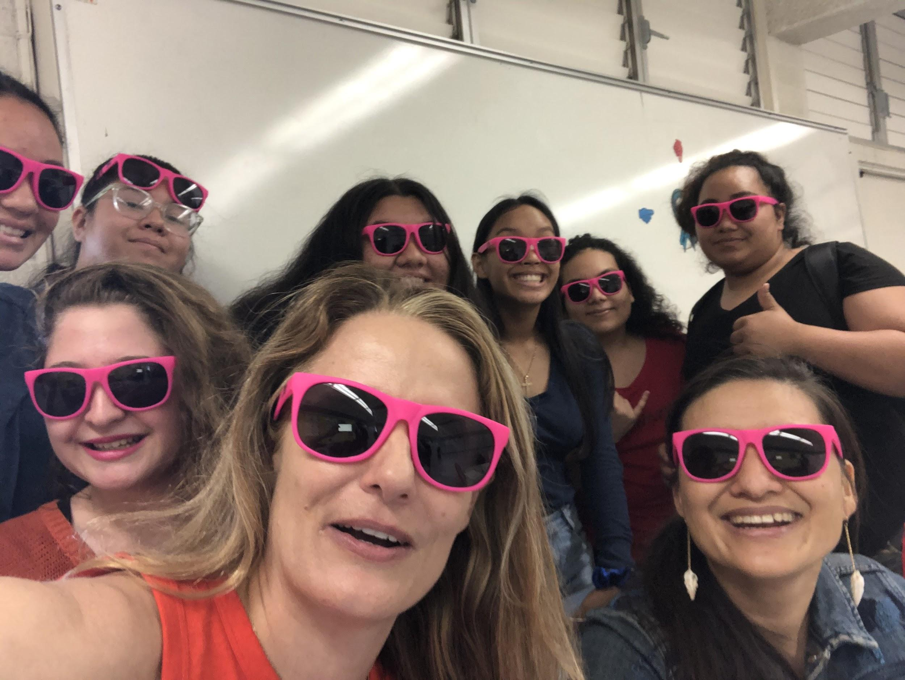
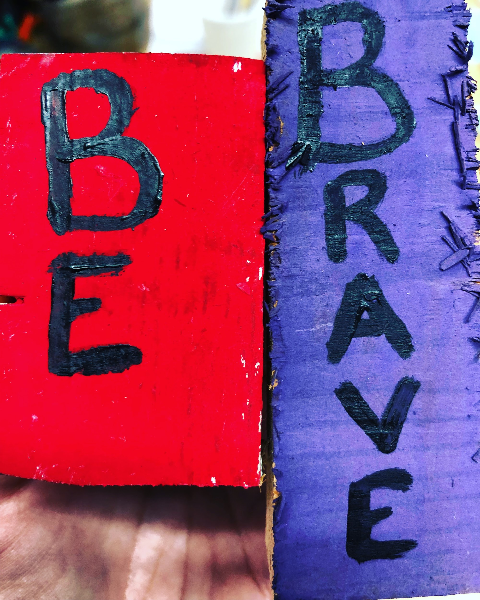
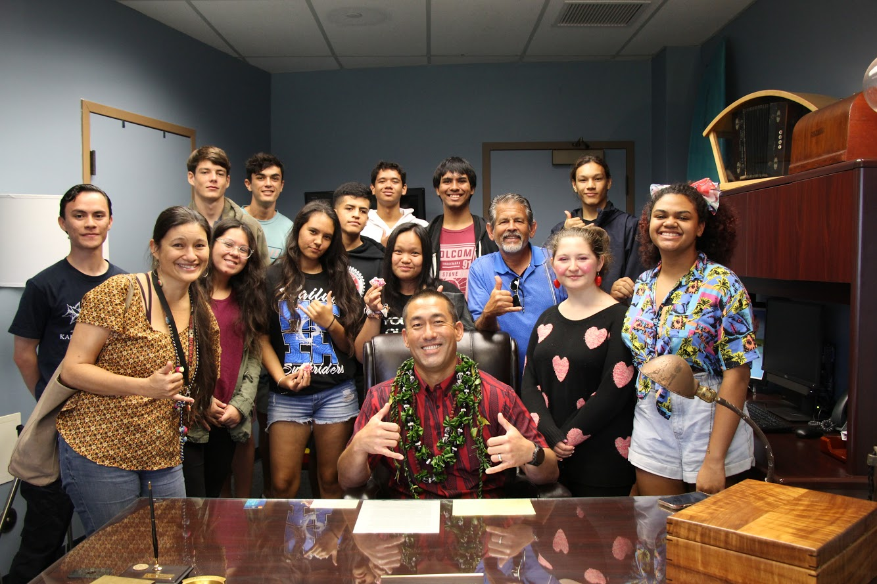
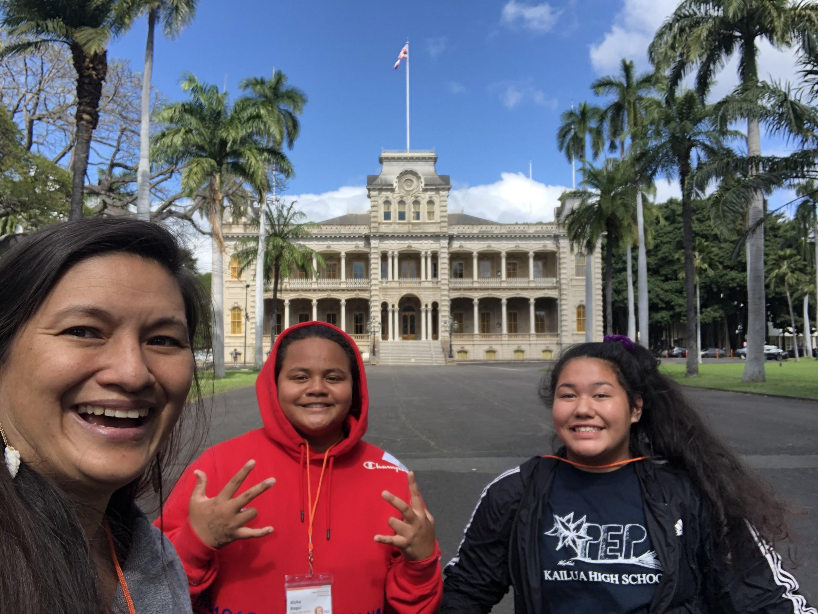

Slide 11
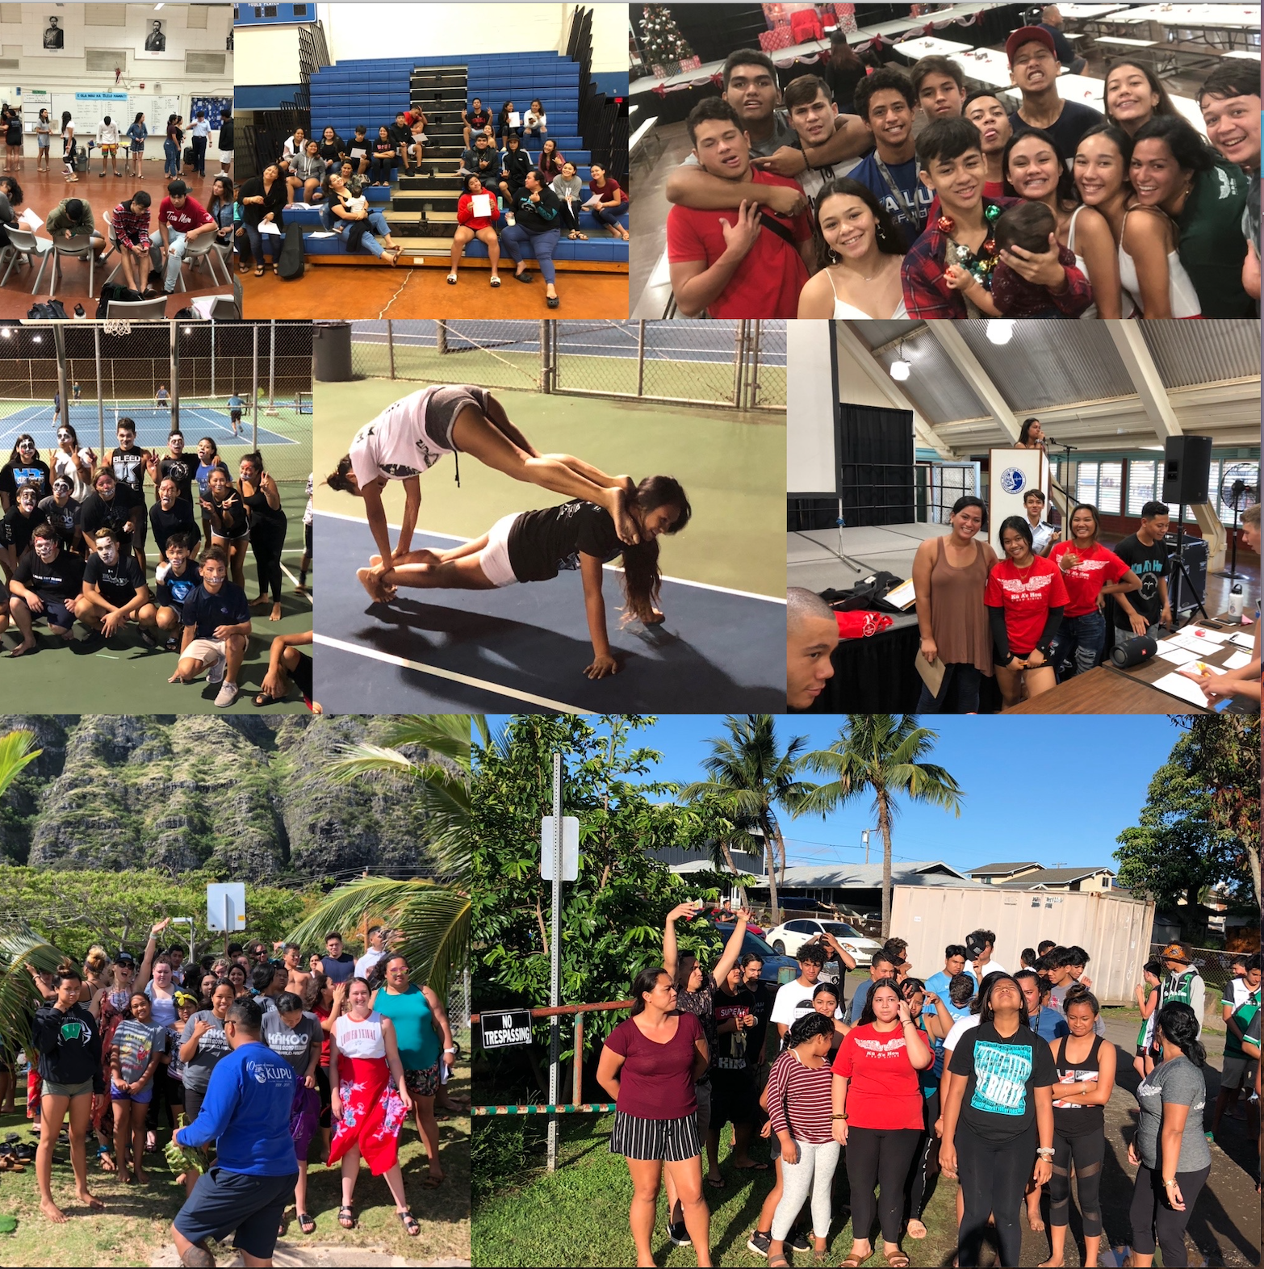
Ku A’e Hou

Slide 12
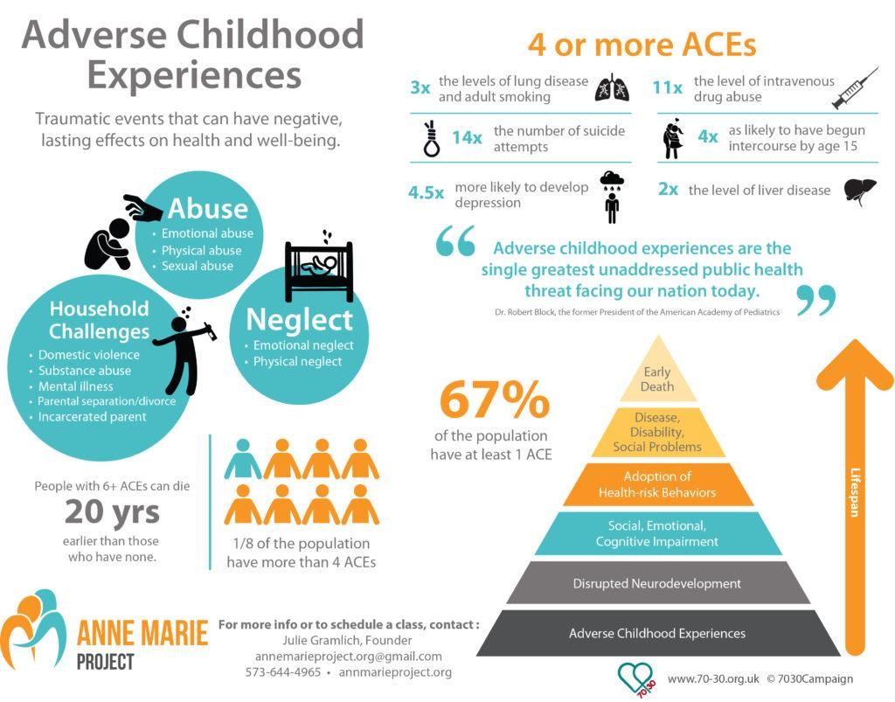
https://images.app.goo.gl/NtUoG8oYDHQ9S68
ACE Test

Slide 13
Review ACE Scores

Slide 14
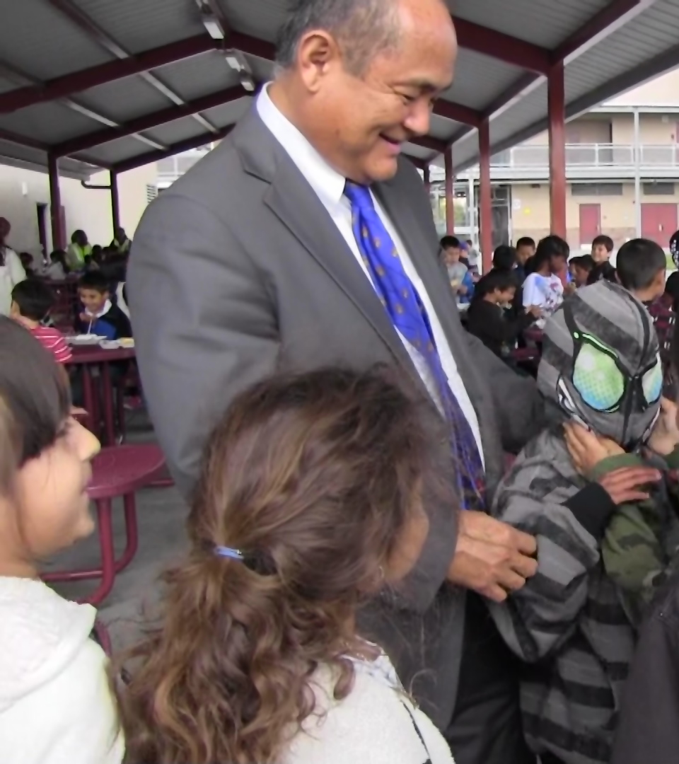
What does a Trauma Informed School Look Like?
Cherokee Point Elementary School

Slide 15
Resources
HIDOE Trauma-Informed Practice Virtual Series - Register
Session One: Trauma-Informed Practices: Wellness and Resilience Strategies for Distance Learning
August 6 - 2:00-3:30 p.m., Danny Goya
Session Two: Trauma-Informed Care (TIC) Strategies for Preparing for the Return to School
August 11 - 1:00-2:30 p.m., Tia Roberts
Session Three: Trauma-Informed Practices: The Cost of Caring - The Essential of Self-Care
August 14 - 1:00-2:30 p.m., Sharon Sims

Slide 16
More Great Resources
SAMHSA’s Concept of Trauma and Guidance for a Trauma-Informed Approach
Trauma-Informed Teaching/Parenting in our New Online Environment
Feeling Stressed or Anxious About the COVID-19 Pandemic?
Paper Tiger's Movie Trailer
Read: a framework for understanding poverty, A Cognitive Approach
Read: Man's Search for Meaning
Read: The Master and his Emissary; The Divided Brain and the Making of the Western World

Slide 17
Questions? Need Support? Contact
Kailua High Counseling
Center 266-7900 ext 2239
shelly.andrews@k12.hi.us
eldon.kohatsu@k12.hi.us

